Slide 1
Employee Data Analysis using Excel
STUDENT NAME: HEMAVATHY S
REGISTER NO: 322200043
DEPARTMENT: COMMERCE ( HONOURS)
COLLEGE: SRI KANYAKA PARAMESWARI ARTS AND SCIENCE COLLEGE WOMEN

Slide 2
PROJECT TITLE
Employee Performance Analysis using Excel

Slide 3


AGENDA
Problem Statement
Project Overview
End Users
Our Solution and Proposition
Dataset Description
Modelling Approach
Results and Discussion
Conclusion
3/21/2024 Annual Review

Slide 4

PROBLEM STATEMENT
The average customer service on-hold time for Example company exceeds five minutes during both its busy and slow seasons.
This can be used to describe a current pain point within an organization that may need to be addressed. Note that the statement specifies that the issue occurs during the company’s slow time as well as the busy season. This is helpful in performing the root cause analysis and determining how this problem can be solved.

Slide 5

PROJECT OVERVIEW
The final step is to choose the type of visualization tool that best supports your metric tracking. Excel provides a range of data visualization tools, no matter the data type you're tracking. For example, dynamic charts allow you to refresh the page view to include recent data updates, while sparklines create small graphs directly associated with the data within a single cell.
.

Slide 6

WHO ARE THE END USERS?
COO (Chief Operating Officer)
HR Manager (Human Resources Manager)
Sales Manager
Marketing Specialist
Financial Analyst
Operations Coordinator
Business Development Manager
Business Development Associate
Accountant

Slide 7

OUR SOLUTION AND ITS VALUE PROPOSITION
SOLUTION : The third advantage of performance review software is increased accuracy. Performance review software can be used to track employee performance in real-time, which helps to ensure that performance reviews are accurate.
Performance review software also typically includes features such as data analysis tools, which can help managers and HR professionals to identify trends in performance reviews and make more informed decisions.

Slide 8
Dataset Description
NAME : The Name Of Employee
NUMBER : Unique indentification Number for employe
Department Type : The Specific Department In The Breach

Slide 9
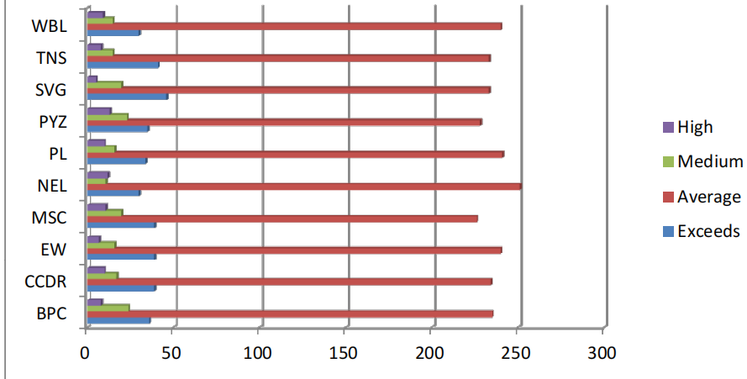
RESULTS

Slide 10
conclusion
A performance evaluation conclusion should briefly summarize a person's performance during the review period, highlighting their key strengths and something they can improve upon:
John consistently exceeds expectations and is always willing to help others. His greatest strengths are his work ethic and his communication skills. As for the areas to work on, he can be a bit more proactive and seek feedback.

